Slide 1









UNIVERSITY OF CAMARINES NORTE
INSTITUTE OF COMPUTER STUDIES
LOGIC
AI/ROBOTICS
ICS
CODE
COMPUTER +
DESIGN

Slide 2


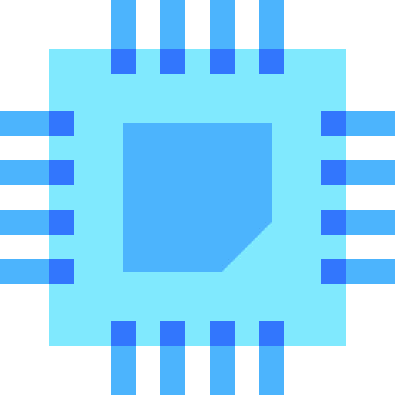



CAMARINES NORTE STATE COLLEGE
INSTITUTE OF COMPUTER STUDIES

Slide 3
CAMARINES NORTE STATE COLLEGE
INSTITUTE OF COMPUTER STUDIES

Slide 4
CAMARINES NORTE STATE COLLEGE
INSTITUTE OF COMPUTER STUDIES

Slide 5
CAMARINES NORTE STATE COLLEGE
INSTITUTE OF COMPUTER STUDIES

Slide 6
UNIVERSITY OF CAMARINES NORTE
INSTITUTE OF COMPUTER STUDIES
LOGIC
AI/ROBOTICS
ICS
CODE
COMPUTER +
DESIGN

Slide 7
LOGIC
AI/ROBOTICS
ICS
CODE
COMPUTER +
DESIGN

Slide 8
LOGIC
AI/ROBOTICS
ICS
CODE
COMPUTER +
DESIGN

Slide 9

ICS

Slide 10


Slide 11
UNIVERSITY OF CAMARINES NORTE
INSTITUTE OF COMPUTER STUDIES

